Slide 2
DF REACH TEST SYSTEM https://dfreach.org

Slide 3
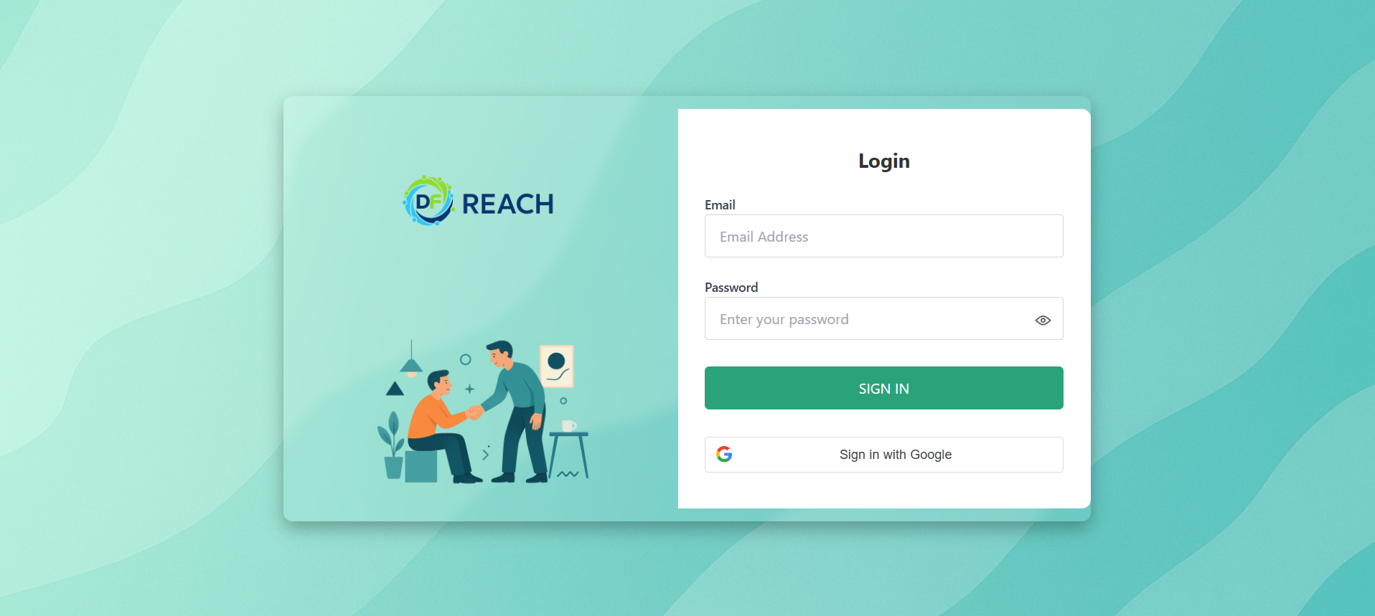
Login Page
You can log in using your DF email and the auto-generated password sent to your registered email address.
OR
You can log in using the Google option with your registered DF email address.

Slide 4
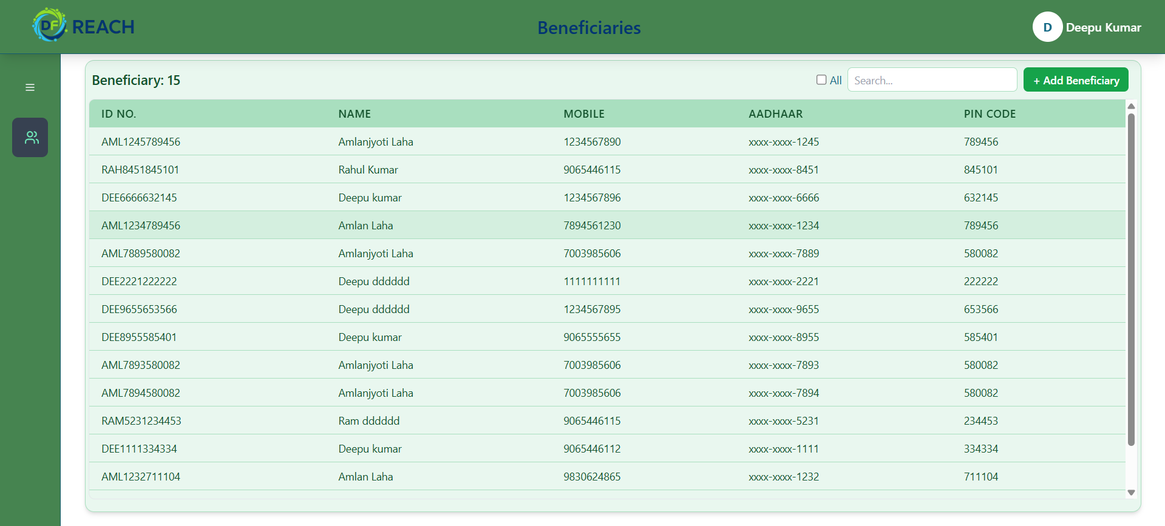
Beneficiaries Page
If a Beneficiary already exists in the system but was not added by you, click on the ALL button and search for the Beneficiary. The Beneficiary will then appear in the list.
You can search for an existing Beneficiary using Name, Mobile, Aadhaar, or Pin code.
This is the Profile section
9999999999
Click the plus (+) button to add beneficiary.
In this section, you can view the list of Beneficiaries you have added.

Slide 5
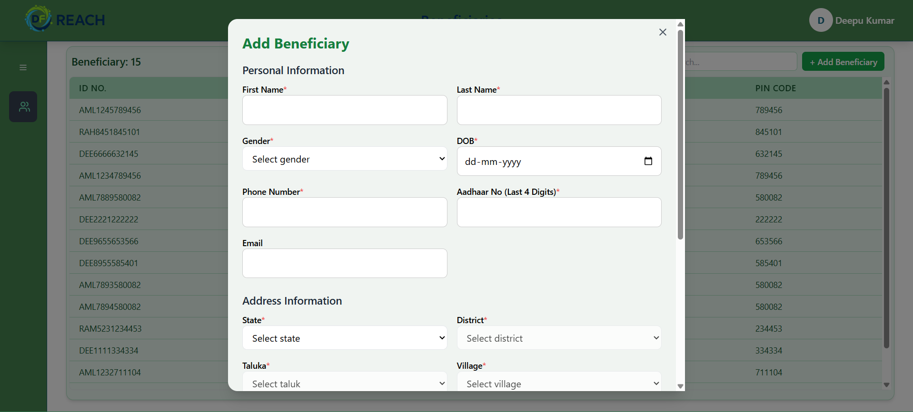
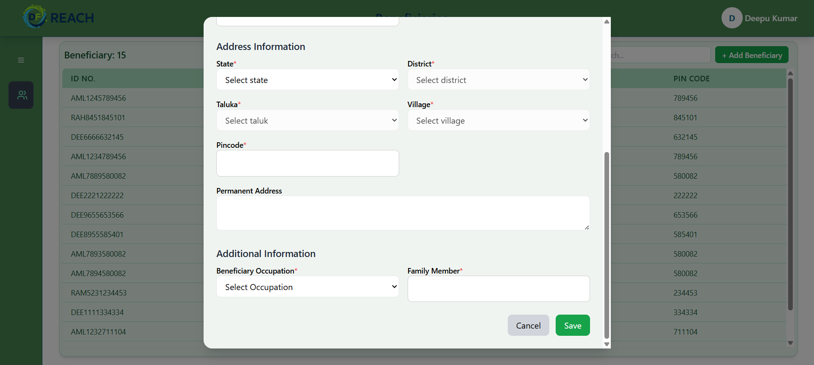
Create NEW Beneficiary
When you click the plus (+) button, this pop-up will appear. You need to fill in all the beneficiary details.
Click on 'Save' to create the beneficiary.

Slide 6
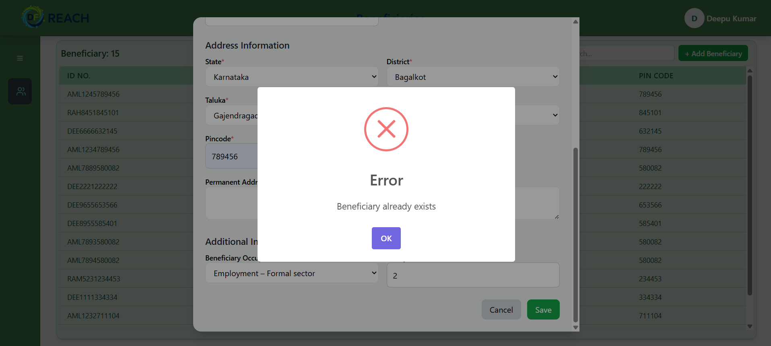
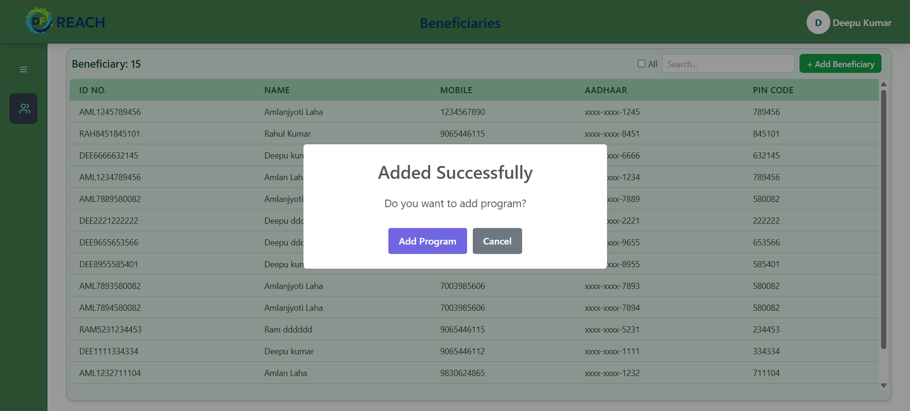
Add Beneficiary Section
If this pop-up appears, it means the Beneficiary already exists in the system. You need to search for the Beneficiary in the list using Name, Aadhaar, Pin code, or Mobile, and then add that Beneficiary to a program.
If this pop-up appears, it means it’s a new Beneficiary. You need to click on Add Program to proceed.

Slide 7
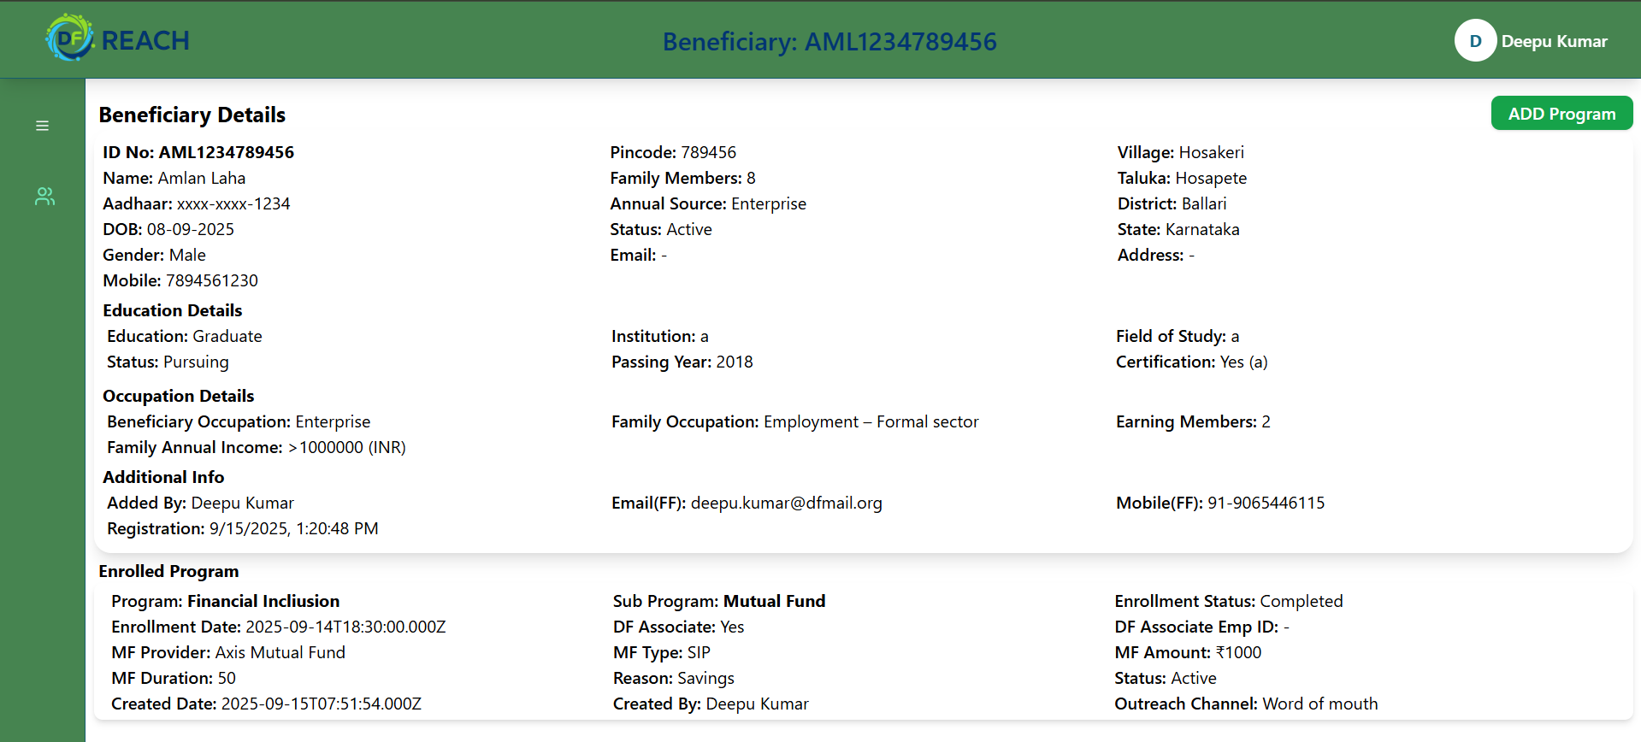
Beneficiary Profile
To add a program for the Beneficiary, you can also click on the Add Program button
9999999999
Inside the Beneficiary profile, you will be able to see all the Beneficiary details along with the programs they are enrolled in.
abc@dfmail.org
9999999999

Slide 8
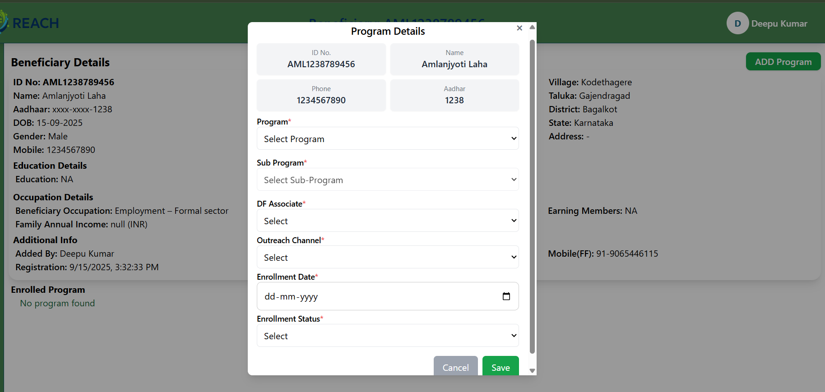
Add Program Details
Whether you click Add Program inside the Beneficiary details or while adding a new Beneficiary, you will see a pop-up containing the program details. After filling in the program-specific fields marked with a red (*) , you can save it.
9999999999
Click Save to add the program to the Beneficiary.

Slide 9
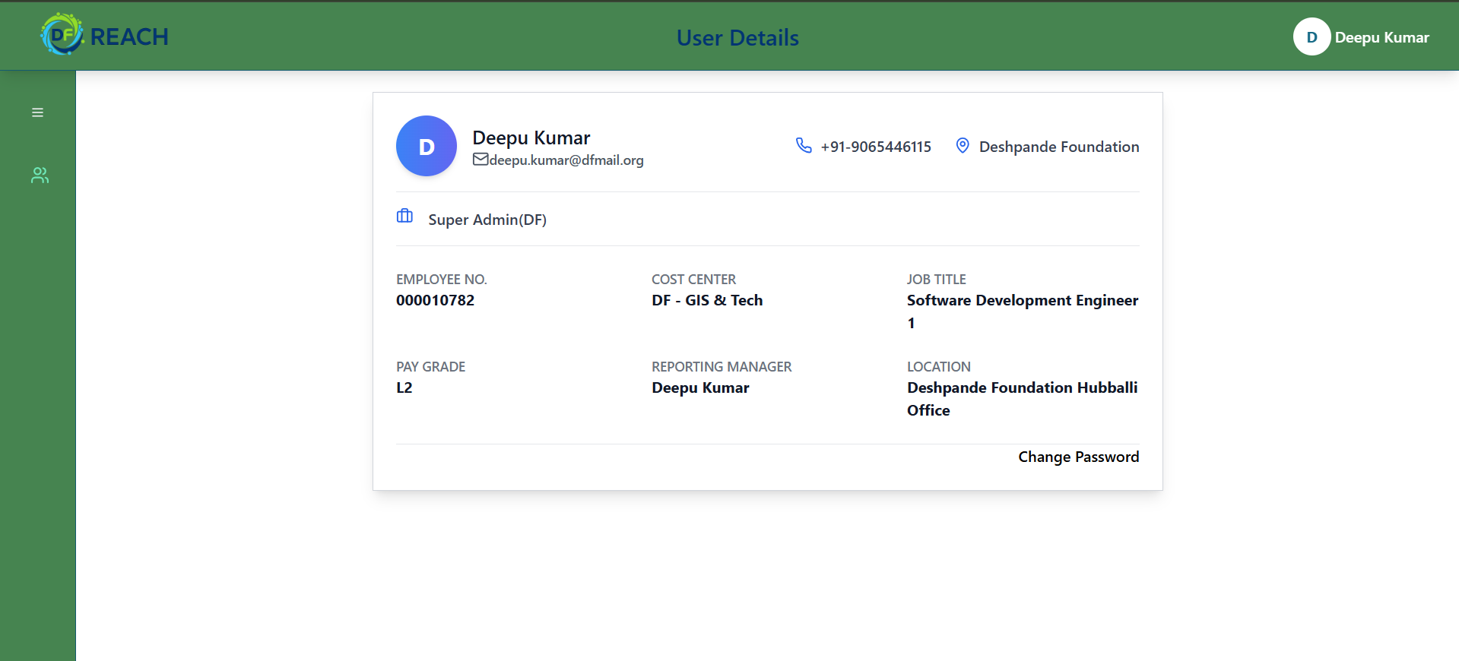
Profile Page
abc.xyz@dfmail.org
999999999
abc@dfmail.org
9999999999
12345
999999999
999999999

Slide 10
Thank You

